Slide 1
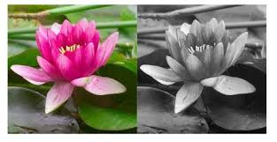
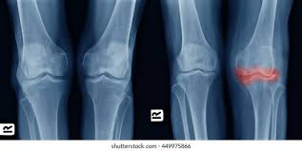
Colour Fundamentals
Why do we use colour in image processing?
Color is an important feature that often facilitates recognition and selection of an object in an image. Eg: face detection using skin colours.
A person is able to distinguish between thousands of different shades and intensities of color and only about two dozen shades of gray.

Slide 2
Color Fundamentals
Categories of Color image processing
Full color image processing
  Images are acquired from full-color sensors or equipments
Pseudo color image processing
  Assigning a shade of color to a particular monochrome intensity or range of intensities.

Slide 3
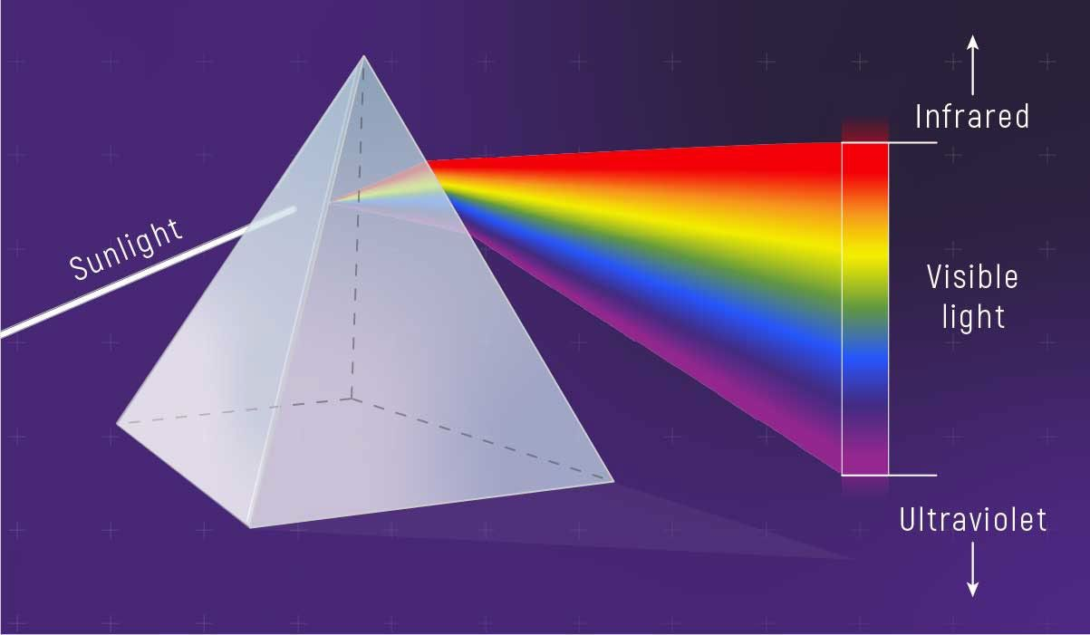
Color Fundamentals

Slide 4
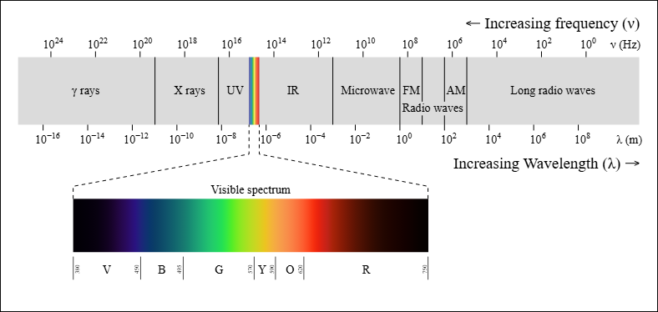
Color Fundamentals

Slide 5
Visible light wavelength is from around 400nm to 700nm.
For achromatic(monochrome) light source, there is only one attribute to describe the quality ie intensity
For a chromatic light source there are three basic attributes to describe the quality:
  Radiance – total amount of energy flow from a light source(Watts)
  Luminance – amount of energy received by an observer
  Brightness – intensity
The Three important quantities to describe the color are :
    Hue - the actual color shade i.e the predominant spectral color
    Saturation - intensity/purity i.e how less the white light is mixed or how much it is diluted.
    Value/Brightness/Intensity - lightness/darkness

Slide 6
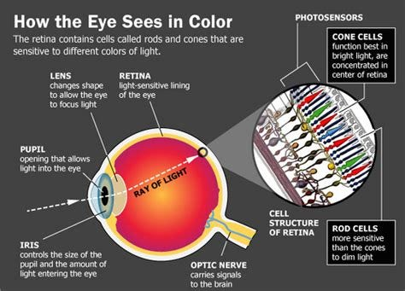
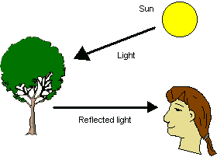
How human eyes sense light
Reflection of light – the colour that the human percieve in an object = light reflected from the object

Slide 7
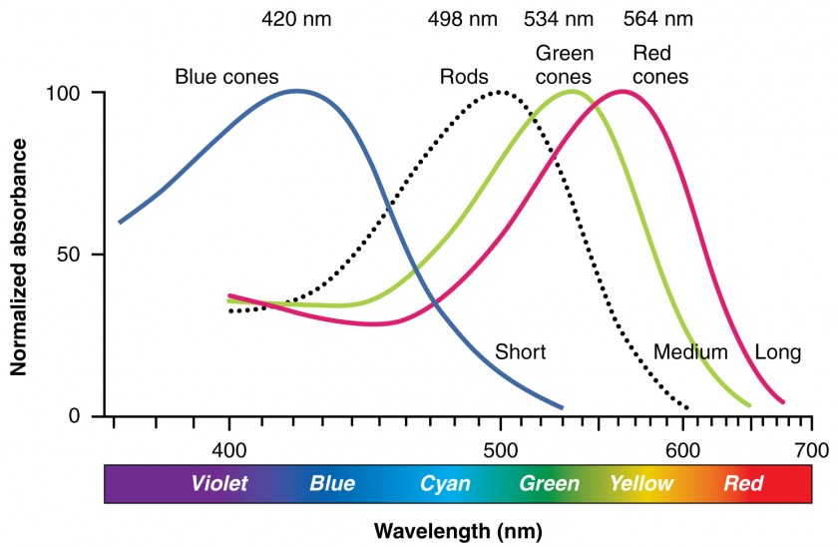
65% Red Light, 33% Green Light, 2% Blue Light

Slide 8
Red, green, and blue cones (L, M, S types) in the eye absorb different wavelengths, peaking around 560-580nm (L-Red), 530nm (M-Green), and 420nm (S-Blue), but they overlap significantly, allowing the brain to interpret combined signals for all colors
Their absorption curves show sensitivity across the visible spectrum, with L-cones for longer (reds/yellows), M-cones for medium (greens/yellows), and S-cones for shorter (blues/violets) wavelengths.

Slide 9
Color Models
  A color model is a mathematical way to describe and represent colors using numbers – typically in tuple like RGB (three values: Red, Green, Blue) or quadruple like CMYK (four values: Cyan, Magenta, Yellow, Black). These values define positions in a coordinate system that helps us encode color information digitally.
Common Color Models in Image Processing
RGB (Red, Green, Blue)
HSI/HSV (Hue, Saturation, Intensity/Value)
YUV/YCbCr (Luminance & Chrominance)

Slide 10
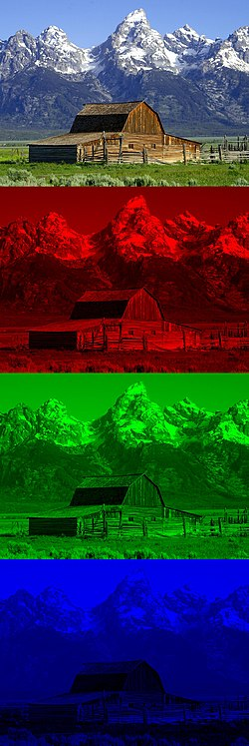
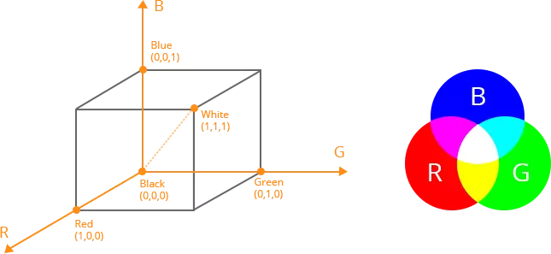
Colour Models
RGB (Red, Green, Blue)
  Concept: Additive model, combining R, G, B to create colors; used for screens and cameras.
  Use: Standard for digital photos, videos, websites, and screens (phones, TVs) due to its additive color model and large gamut.
  With a color space based on the RGB color model, the three primaries are added together to create colors from completely white to completely black. Eg., rgb(255, 0, 0) is pure red, rgb(0, 0, 0) is black, and rgb(255, 255, 255) is white

Slide 11
Colour Models
HSI color model (Hue, Saturation, Intensity)
A system used in image processing that mimics human perception by separating color (Hue, Saturation) from brightness (Intensity). Hue is the pure color (like red, green, blue), Saturation is its purity (how much gray it has), and Intensity is its brightness or darkness, making it excellent for tasks like changing colors or adjusting brightness without affecting the hue.
  Hue (H): The actual color, often represented as an angle (0-360°), where 0° is red, 120° green, and 240° blue.
  Saturation (S): The intensity or richness of the color, ranging from 0 (gray) to 1 (fully saturated color).
  Intensity (I): The brightness of the color, ranging from 0 (black) to 1 (white).
  Use: Ideal for tasks where brightness or color content needs independent adjustment (e.g., skin detection).

Slide 12
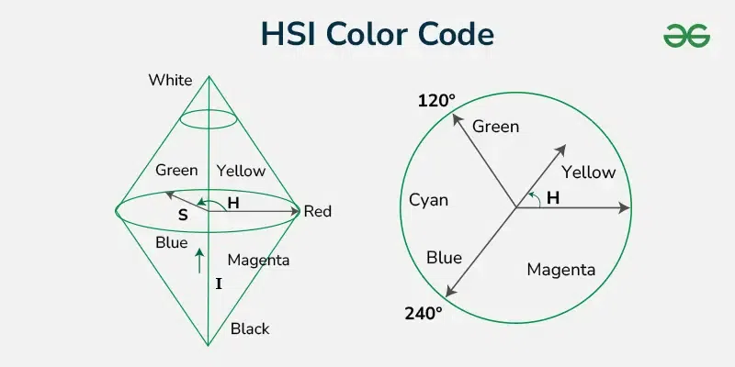
Colour Models

Slide 13

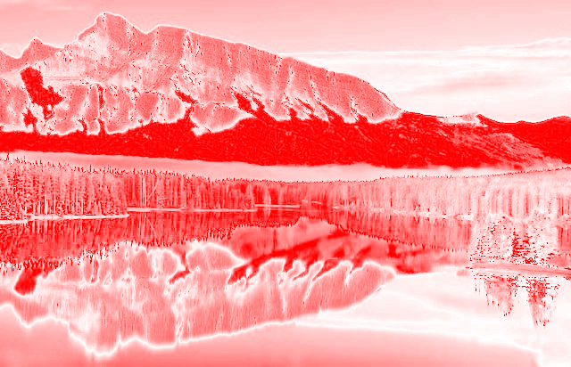
Colour Models
HSI
Ideal for algorithms that need to manipulate specific color aspects (like changing all reds to blues) while preserving brightness, or vice versa.

Slide 14

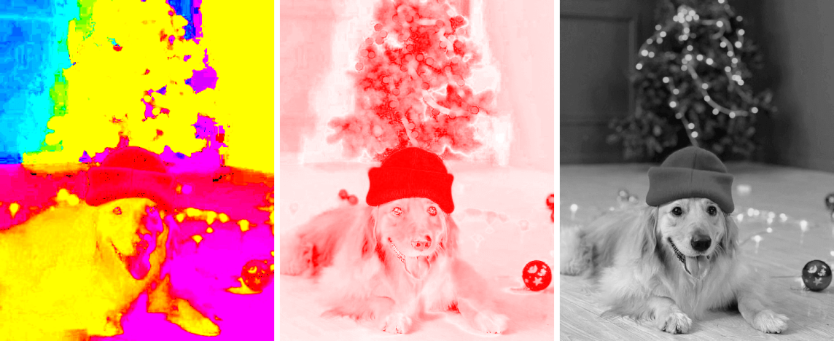
Colour Models

Slide 15
YUV/YCbCr (Luminance & Chrominance):
  Separates luminance (Y, brightness) from chrominance (U/V or Cb/Cr, color information) ie it breaks the signal down into a Y, or luminance channel, and 2 channels that store color info without brightness info – a Blue channel and a Red channel that don’t contain any brightness.
  Luminance (Y): Represents the brightness in an image (the 'Y' component) and carries the black and white (grayscale) information.
  Chrominance (Cb and Cr): Encodes the color information of the pixel (the 'Cb' and 'Cr' components). 'Cb' stands for blue-difference chroma, while 'Cr' represents red-difference chroma.

Slide 16
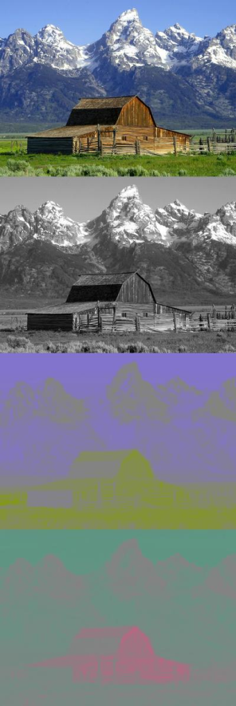
You can see that YUV provides essentially a “grayscale” image from one channel, and the color information is separated out into 2 channels – one for Blue information minus the brightness, and one for Red info minus the brightness. In this image, the Blue channel is showing purple/yellow colors, and the Red channel has more red/cyan colors in this particular image.
The white snow in the shots has a grey color in both the color channels. That’s because it has a 0 value in both color channels. The barn has a negative value in the Blue channel (producing a yellowish color) and a positive value in the Red channel (producing, well, red colors.) Green colors are derived from a mix of negative values in both channels.
Images have negative values in YUV's U (blue-yellow) and V (red-cyan) chrominance channels because they represent color difference signals, where zero is a neutral gray, and positive/negative values shift the color towards one extreme or the other. A negative U value might push towards yellow, while a positive V pushes towards red, encoding color information relative to brightness (Y).

Slide 17
  Use of YUV images:
  The adoption of the YCbCr color space in digital image processing is particularly prominent due to its ability to balance quality and storage efficiency. As the color information is compressed more than the brightness because the human eye is more sensitive to changes in brightness than color, the U and V channels can be sampled at a lower resolution than the Y channel to reduce data size with minimal perceptual quality loss. YCbCr enables the retention of essential visual details while reducing data size.
  The YCbCr color space is instrumental in image compression, particularly in JPEG compression, due to its structure that separates color into luminance (Y) and chrominance (Cb and Cr) components. This results in a smaller file size, demonstrating YCbCr’s effectiveness in reducing data redundancy in image processing.
  YCbCr color space plays a critical role in image segmentation, which involves dividing an image into segments to simplify or change the representation of an image. By separating chrominance from luminance, YCbCr allows for more precise segmentation since variations in lighting and shadows have a reduced impact on the chrominance components, leading to more accurate detection and isolation of objects within an image.

Slide 18
Image File Formats
- defines how digital images are stored and compressed.
They fall primarily into two categories:
Raster formats (pixel-based)
Vector formats (mathematically defined shapes)
Eg: SVG(Scalable Vector Graphics).svg
AI(Adobe Illustrator).ai

Slide 19
Raster Formats
Raster formats, such as JPEG and PNG, are composed of a grid of pixels and are commonly used for photographs and complex graphics. They are resolution-dependent and may become pixelated if enlarged excessively.
  JPEG/JPG (Joint Photographic Experts Group): Great for photos, uses lossy compression (reduces quality for smaller size).
  PNG (Portable Network Graphics): Supports transparency and lossless compression, ideal for web graphics, logos.
  GIF (Graphics Interchange Format): Supports simple animations and transparency, limited colors.
  TIFF/TIF (Tagged Image File Format): High quality, lossless, large files, used for printing and archiving.
  BMP (Bitmap): Uncompressed, large files, basic format.

